Slide 1
Building native mobile Applications
With NG Schematics and Nativescript

Slide 2
agenda
WHAT’S THE STORY?
WHY NATIVE?
ONE APPLICATION, MULTIPLE DEVICES
NATIVE, But with A Script
THE SCHEME IN SCHEMAtics
Bringing up The CIty
Further READINGS

Slide 3

It all started in…

Slide 4
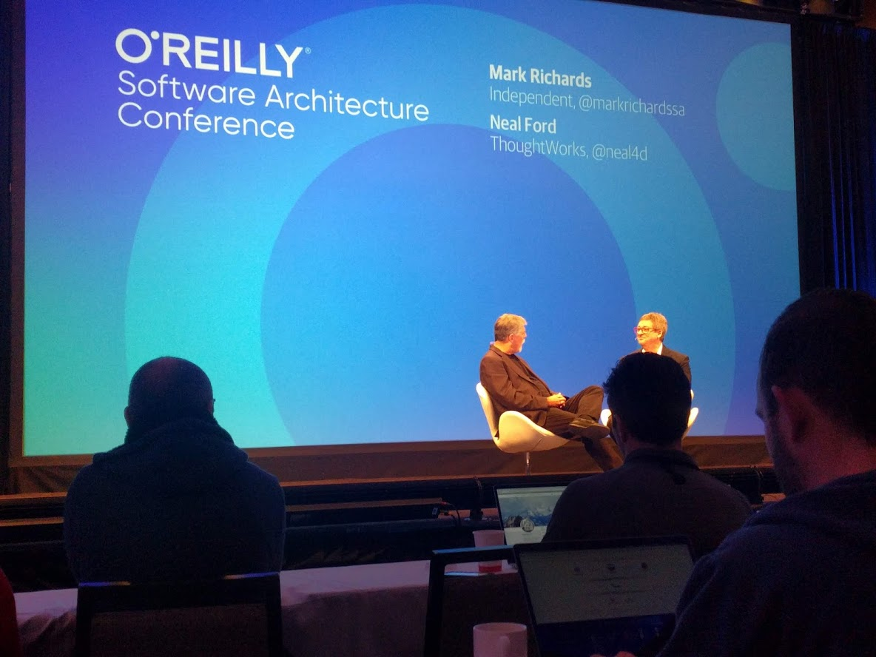
Piling Up Inspiration…

Slide 5


What’s the Story
Things I suck at…

Slide 6

What’s the Story
The beginning of the Endava Courses
Application starts with beer…

Slide 7
agenda
WHAT’S THE STORY?
WHY NATIVE?
ONE APPLICATION, MULTIPLE DEVICES
NATIVE, But with A Script
THE SCHEME IN SCHEMAtics
Bringing up The CIty
Further READINGS

Slide 8
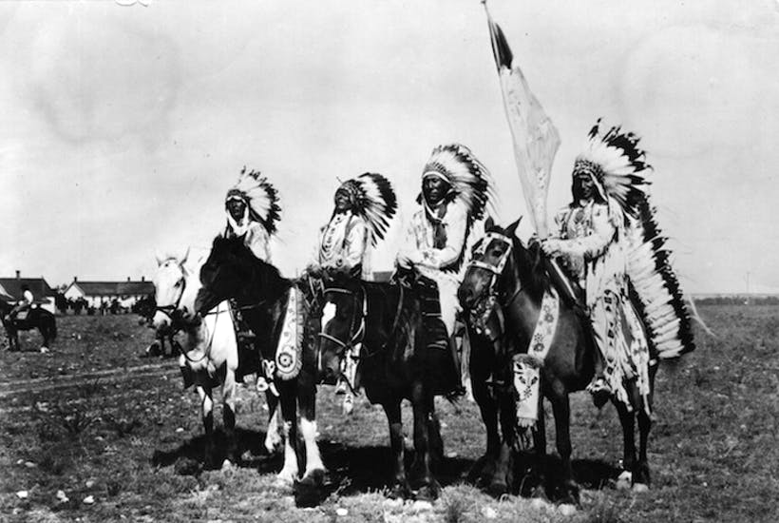
WHY NATIVE?
Better user experience (native gestures, animations, styling).
Better performance than other WebView or progressive web applications.
Predictability of code behaviour in different environments (interpreted JavaScript runs at different speeds for different engines comparing to bytecode, which will mostly have same speed ranges)

Slide 9
agenda
WHAT’S THE STORY?
WHY NATIVE?
ONE APPLICATION, MULTIPLE DEVICES
NATIVE, But with A Script
THE SCHEME IN SCHEMAtics
Bringing up The CIty
Further READINGS

Slide 10


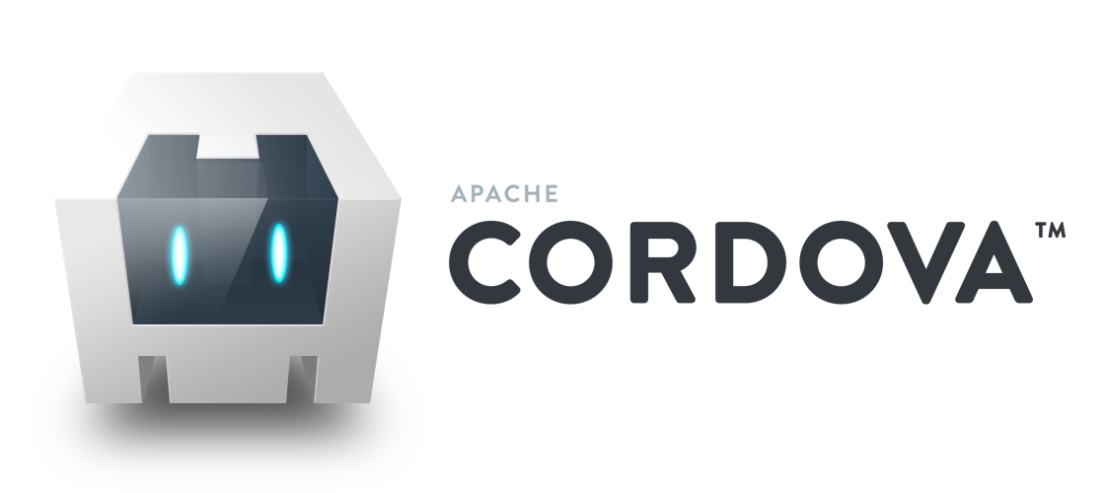




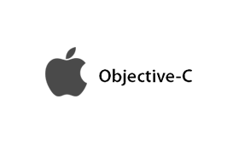
ONE SHARED APPLICATION, MULTIPLE DEVICES
Native Native with scripting WEB VIEW

Slide 11
ONE SHARED APPLICATION, MULTIPLE DEVICES
SAME CODEBASE FOR WEB AND MOBILE (IOS AND ANDROID)
Code | Native Android | Native iOS | Web
Components | Shared | Shared | Shared
Services | Shared | Shared | Shared
Libraries | Shared | Shared | Shared
Backend | Shared | Shared | Shared
Modules and Routing | Same for Android and iOS | Same for Android and iOS | Different
Component Templates(HTML and XML) | Different | Different | Different
By using NativeScript in a shared web/mobile application you can achieve up to 70 - 80% code reusability between environments.

Slide 12
agenda
WHAT’S THE STORY?
WHY NATIVE?
ONE APPLICATION, MULTIPLE DEVICES
NATIVE, But with A Script
THE SCHEME IN SCHEMAtics
Bringing up The CIty
Further READINGS

Slide 13

NATIVE, BUT WITH A SCRIPT
HOW DOES IT FEEL

Slide 14

NATIVE, BUT WITH A SCRIPT
If it walks like a native, RUNS like a native…

Slide 15

NATIVE, BUT WITH A SCRIPT
Who makes this possible

Slide 16

NATIVE, BUT WITH A SCRIPT
WHAT IS NATIVESCRIPT REALLY?

Slide 17
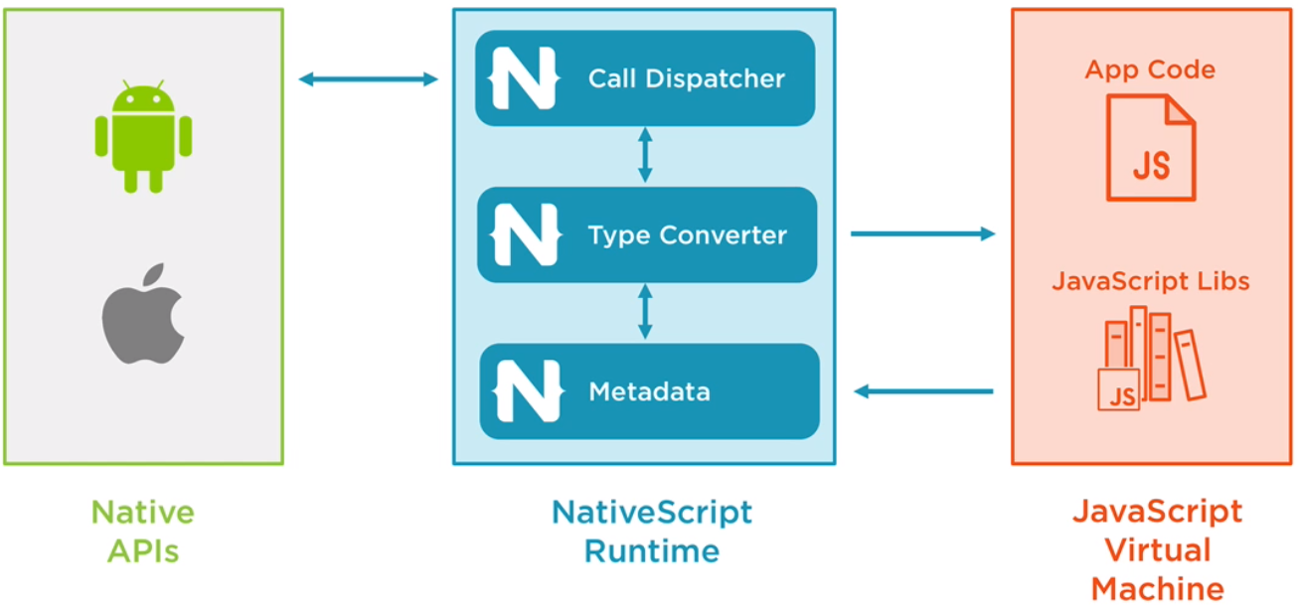
NATIVE, BUT WITH A SCRIPT
THE RUNTIME

Slide 18
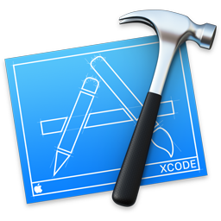

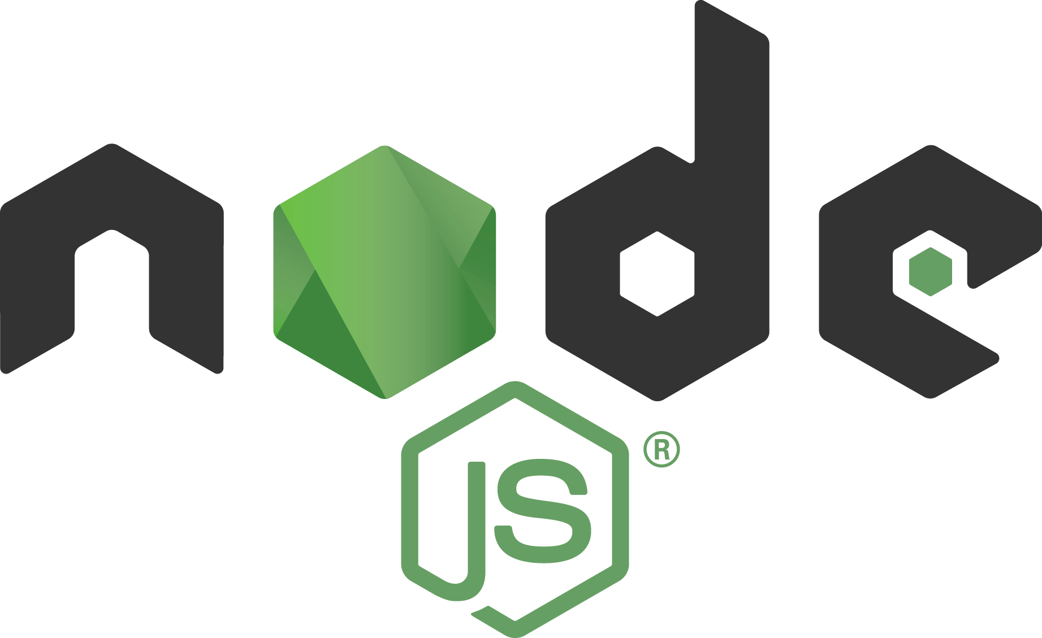
NATIVE, BUT WITH A SCRIPT
ECOSYSTEM

Slide 19
NATIVE, BUT WITH A SCRIPT
THE NATIVESCRIPT CLI
Use either
nativescript <command> or
tns <command>
Usual commands:
>tns create
>tns platform
>tns install
>tns run
>tns debug
>tns livesync

Slide 20
agenda
WHAT’S THE STORY?
WHY NATIVE?
ONE APPLICATION, MULTIPLE DEVICES
NATIVE, But with A Script
THE SCHEME IN SCHEMAtics
Bringing up The CIty
Further READINGS

Slide 21

THE SCHEME IN SCHEMATICS
The Tool that helps Angular to bring Native to Life

Slide 22
THE SCHEME IN SCHEMATICS
CREATING AN ANGULAR APP WITH NATIVESCRIPT
NativeScript only
ng new --collection=@nativescript/schematics my-mobile-app
NativeScript shared web and mobile
ng new --collection=@nativescript/schematics my-shared-app --shared

Slide 23
agenda
WHAT’S THE STORY?
WHY NATIVE?
ONE APPLICATION, MULTIPLE DEVICES
NATIVE, But with A Script
THE SCHEME IN SCHEMAtics
Bringing up The CIty
Further READINGS

Slide 24
BRINGING UP THE CITY
Migrating Web Modules to Shared Modules
You can use ng generate migrate-module to convert a Web Module to a Shared Module and also convert all of its Components. This includes the following steps:
add module-name.component.tns.ts
convert all of modules' components, by using migrate-component schematic
copy over all providers from the web module

Slide 25
BRINGING UP THE CITY
Having the same codebase
You can have the same codebase:
using modules with different extensions (.ts and .tns.ts) + achiving routing for each type of module.
Using templates with different extensions (.html and .tns.html)
For all others Components, Services, libraries and backend), everything remains the same

Slide 26
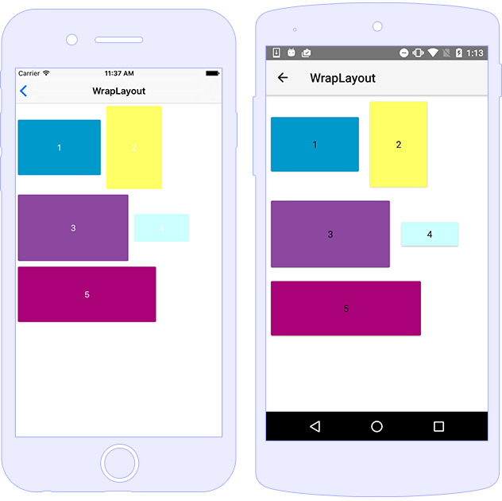
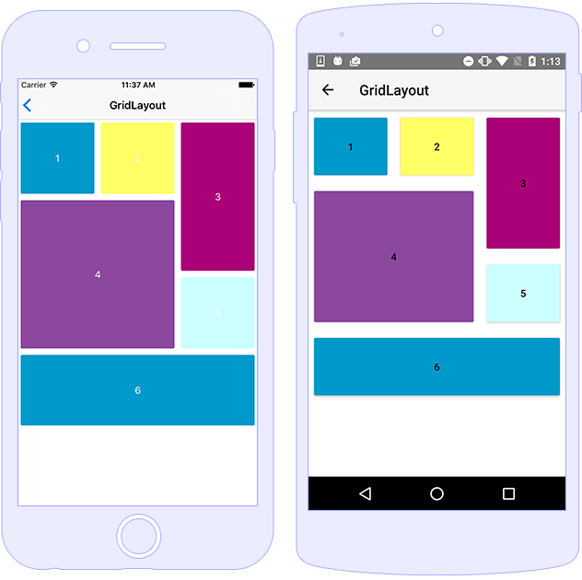
BRINGING UP THE CITY
What is truly Different

Slide 27

Pitfalls
Migrating Web Modules to Shared Modules
Lots of configurations (environments and tools)
Not easy to build (devops knowledge may be needed to automate some tasks)
Mobile development knowledge should be added on top of frontend development knowledge (not easy to deal with in the beginning)

Slide 28
agenda
WHAT’S THE STORY?
WHY NATIVE?
ONE APPLICATION, MULTIPLE DEVICES
NATIVE, But with A Script
THE SCHEME IN SCHEMAtics
Bringing up The CIty
Further READINGS

Slide 29
Further Readings
Docs and Application Link
Angular Documentation:
https://angular.io/docs
NativeScript Documentation
https://docs.nativescript.org/
Angular Integration with NativeScript
https://www.nativescript.org/angular-mobile-landing-page
Endava Course App Link:
https://github.com/liviualexandrubobocu/endava-courses/

Slide 30

Thank you

